Slide 1
When you start thinking a lot about your past, it becomes your present and you can’t see your future without it.

Slide 2
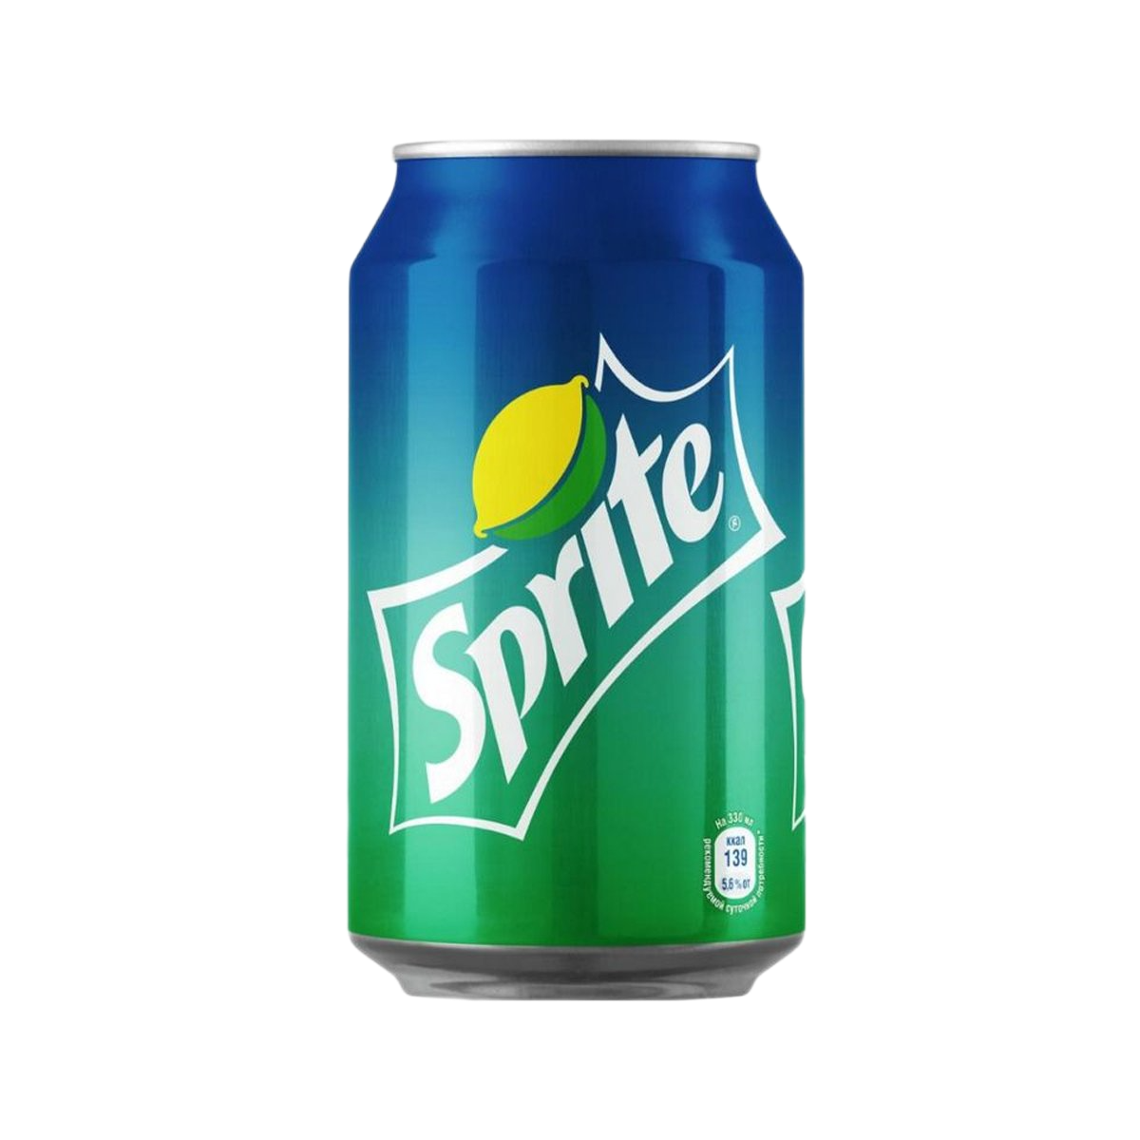
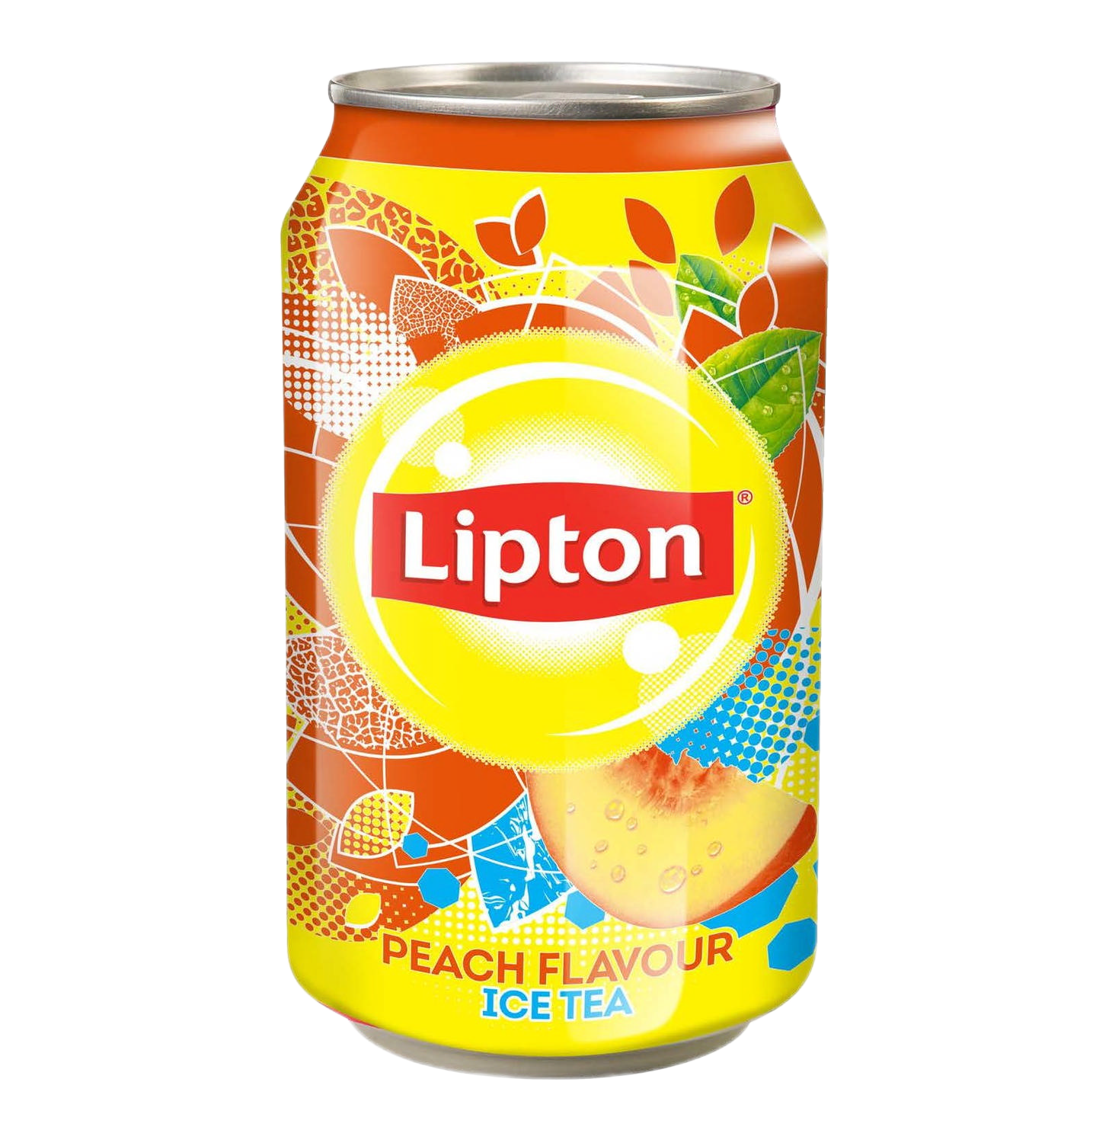
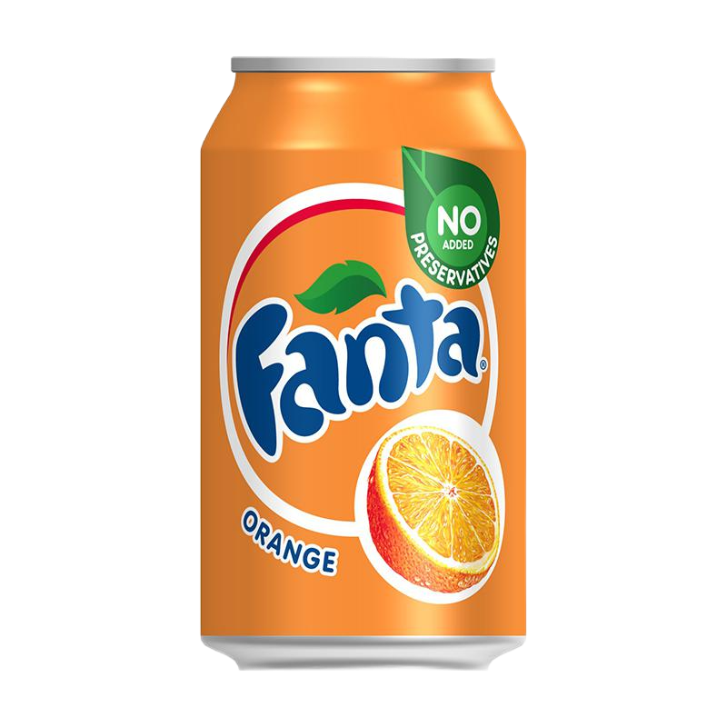
Ingredients: water, sugar, fructose, green tea extract, acidity regulators (citric acid, sodium citrate 3-substituted), natural flavor, preservatives (potassium sorbate, dimethyl bicarbonate), antioxidant ascorbic acid. Nutritional value per 100 g: protein 0 g, fat 0 g, carbohydrates 6.9 g, energy value 30 kcal Shelf life: 365 d. Storage conditions: store at a temperature of 0 °C to +35 °C.

Slide 3
Composition. Water, sugar, orange juice from concentrate (3.7%), citrus fruits from concentrate (1.3%), citric acid, vegetable extracts (carrot, pumpkin), sweeteners (acesulfame K, sucralose), preservative (potassium sorbate), malic acid., acidity regulator (sodium citrate), stabilizer (guar gum), natural orange flavors with other natural flavors, antioxidant (ascorbic acid).

Slide 4
Sprite invigorates, improves performance, gives strength and energy, improves memory and motivation.Ingredients: Purified water, sugar, acidity regulators (citric acid, sodium citrate), natural flavors, sweeteners (acesulfame potassium, aspartame, neohesperidine dihydrohalcone). The product contains a source of phenylalanine. Storage conditions. Store at a temperature from 0 °C to +30 °C away from direct sunlight.

